Slide 1
Distributed Temperature Sensing (DTS) Overview
For PRODML v2.0

Slide 2
Overview
This presentation deck includes slides for the set of objects for distributed temperature sensing (DTS). For more information, see the PRODML Technical Usage Guide, which is included in the zip file when you download PRODML from the Energistics website.

Slide 3
DTS Introduction
Temperature measurement spatially distributed over thousands of points
Used in hundreds of facilities for, e.g.:
real-time surveillance,
status of gas lifted or steam wells,
casing /tubing integrity,
leak detection on pipelines
Use is growing and new fiber measurements are emerging

Slide 4
Goals for PRODML DTS Project
Support requirements sufficient for industry-wide adoption.
Data transmission, storage, and interfaces
Fiber Asset Management
Metadata
Provide PRODML schema & guidelines so vendor software can be interchangeable, allowing mix-and-match hardware and software
Create compelling standard that attracts OCs and vendors
...promoting products that plug into multiple vendors hardware for data acquisition and integrate out of the box with consumer products on the front-end.

Slide 5
DTS Challenges
Data is traces (like logs) not point values
~ 1MB per trace per ~ minute per well
Configuration and condition of fiber needs to be known and managed
Complex configurations becoming common
Condition, faults etc. change over time
No standard interface for whole data transfer (earlier PRODML partial coverage and not fully standardized)

Slide 6
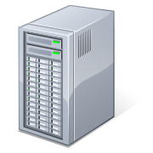
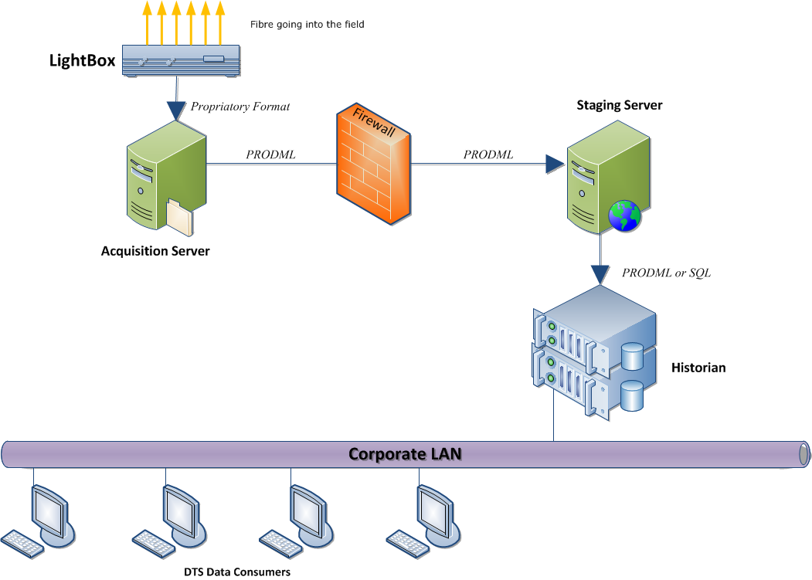
Typical DTS System and challenges
Field
Office Domain
DTS Repository
Inventory Mgmt.
PRODML V1 or other
reliability problems
Not related hence data not mapped to assets
Proprietary
Proprietary and largely manual
Instrument
Box
Historian &
Completion Data
Surveillance &
Analysis Tools
DTS
Fiber
DTS
Fiber
Wells
Pipelines
Heaters
Leak Detection…
Config changes over time
Product Scope
Notes:
Transport App: It’s the UPS for ASP.
Robust and Reliable mechanism for sending data over to the office domain.
Future Proof: Supports any type of advanced sensing data, not only DTS. (File based).
Based on Shell Global Standards: No need for step-outs.
Based on Industry Standards: Vendors can easily make use of the transport mechanism or its infrastructure (i.e. Schlumberger)
Traffic Light Web App: It’s the CNN for ASP
Provide complete transparency on the status of the ASP world. Have confidence that ASP data is being generated and managed properly.
Quality tagging of all data received. Early detection of problems down the line. Have confidence that ASP data is good and will be useful.
Get notified when something goes wrong. Don’t find out when it’s too late.
Preview/Selection Site: It’s the Music Store for ASP
Browse all the ASP related files that have been received in the office domain. No more digging around endless folders in network shares.
Preview their contents before you download.
Compare ASP data against PI readings to help you select the date range of your interest. No more manual filtering based on guesses.
Compare ASP data against Well Completion data. Quickly determine the level of calibration that may be needed before attempting any time-consuming work.

Slide 7
PRODML DTS Enhancements
Provide Standard interface for acquiring data from Instrument box of multiple vendors
Provide standard transport to move data across varying infrastructures and security zones.
Provide storage that retains current and historical information on fiber assets, and measurements/quality, calibration, and actions taken on/from these assets.
Provide a standard interface to allow visualization, analytics, and other consumers to access out of the box.

Slide 8
Typical DTS System Exploiting PRODML
Field
Office Domain
Transport App
DTS Repository
PRODML
Inventory Mgmt.
Portal
PRODML
PRODML-enabled transport app resolves reliability problems
View and Manage DTS related Assets
PRODML
PRODML
Instrument
Box
Surveillance &
Analysis Tools
Historian &
Completion Data
PRODML
DTS
Fiber
DTS
Fiber
Config changes over time
Wells
Pipelines
Heaters
Leak Detection…
Product Scope
Notes:
Transport App: It’s the UPS for ASP.
Robust and Reliable mechanism for sending data over to the office domain.
Future Proof: Supports any type of advanced sensing data, not only DTS. (File based).
Based on Shell Global Standards: No need for step-outs.
Based on Industry Standards: Vendors can easily make use of the transport mechanism or its infrastructure (i.e. Schlumberger)
Traffic Light Web App: It’s the CNN for ASP
Provide complete transparency on the status of the ASP world. Have confidence that ASP data is being generated and managed properly.
Quality tagging of all data received. Early detection of problems down the line. Have confidence that ASP data is good and will be useful.
Get notified when something goes wrong. Don’t find out when it’s too late.
Preview/Selection Site: It’s the Music Store for ASP
Browse all the ASP related files that have been received in the office domain. No more digging around endless folders in network shares.
Preview their contents before you download.
Compare ASP data against PI readings to help you select the date range of your interest. No more manual filtering based on guesses.
Compare ASP data against Well Completion data. Quickly determine the level of calibration that may be needed before attempting any time-consuming work.

Slide 9
Use Cases and Key Concepts

Slide 10
Principle Use Cases
Configuration of & changes in fiber assets
Optical path comprising: fiber segments, connectors, splices, conveyance, anomalies…
Instrument box + path combinations: generate data
Calibrations and condition monitoring
For an installed DTS system, transfer trace data from field to office
Transfer temperature data mapped from trace to actual facilities (wells, pipes, etc.)

Slide 11
Top Level Data Objects
Optical Path
(series of fiber segments & components)
Instrument Box
(surface “Light Box” instrument)
Pairing in time of
Installed System
(path + box which makes measurements)
Generates
Measurement Set
(Measured Trace of raw data plus Log of temperature mapped to facilities)

Slide 12
Optical Path
Describes all components through which light passes (fiber + other components)
Can span more than one wellbore
Provides mapping from path length to position in a facility (wellbore or pipeline)
Records defects that impact measurements
Conveyance
Shows changes versus time

Slide 13
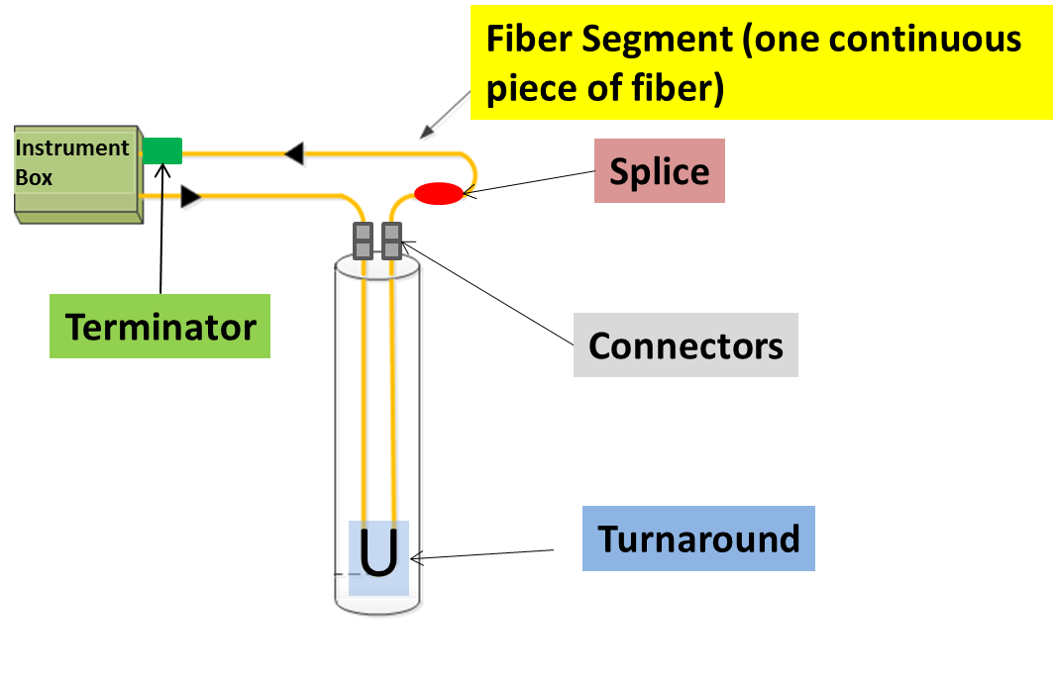
Optical Path Components

Slide 14
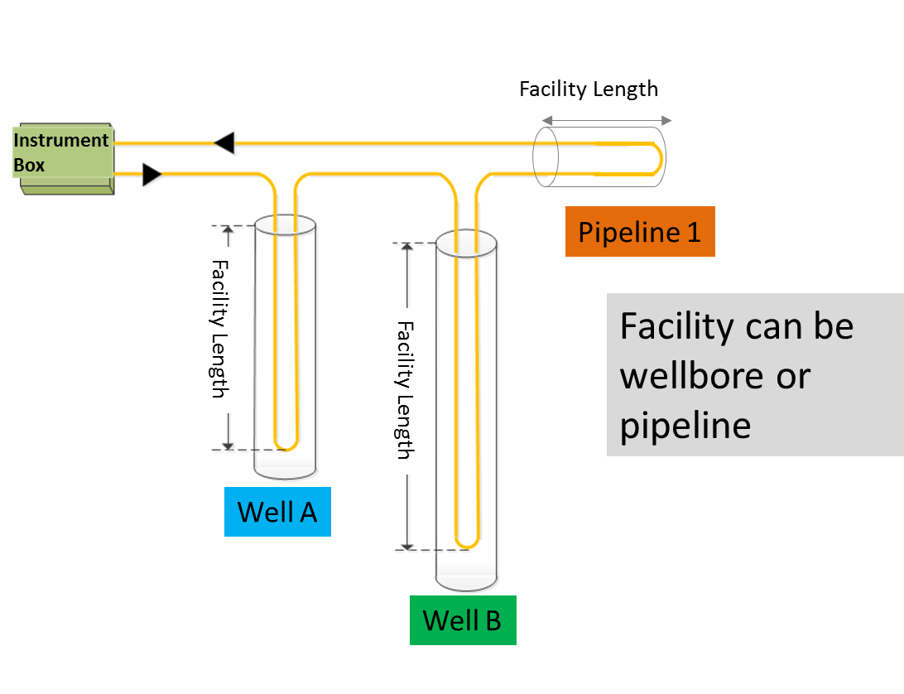
Optical Path Can Span Multiple Facilities

Slide 15
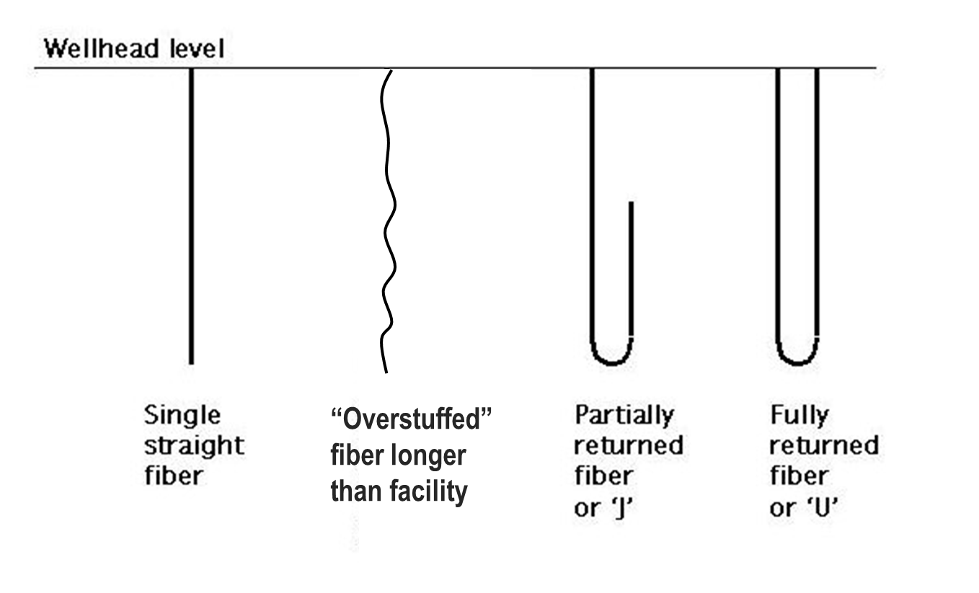
Fiber may be linear or “folded” along the facility (well, pipeline etc.) being measured

Slide 16
Optical Path Connectivity Representation
PRODML Network Representation
Network (represents the whole optical path)
Unit (represents each component)
Port (place where component connects)
Node (virtual point of connection)
Section illustrated
Ins. Box port
fiber segment 1
connector 1
fiber segment 2
Node a
Node b
Node…
Port 1
Port 2
Port 1
Port 2
Port 1
Port 2
First component (and terminator*) can name Instrument Box port connected
Each component is a “unit”
Each unit has 2 ports
Ports with a common “connected Node” are connected
Etc.
* - for double ended systems looped back to box

Slide 17
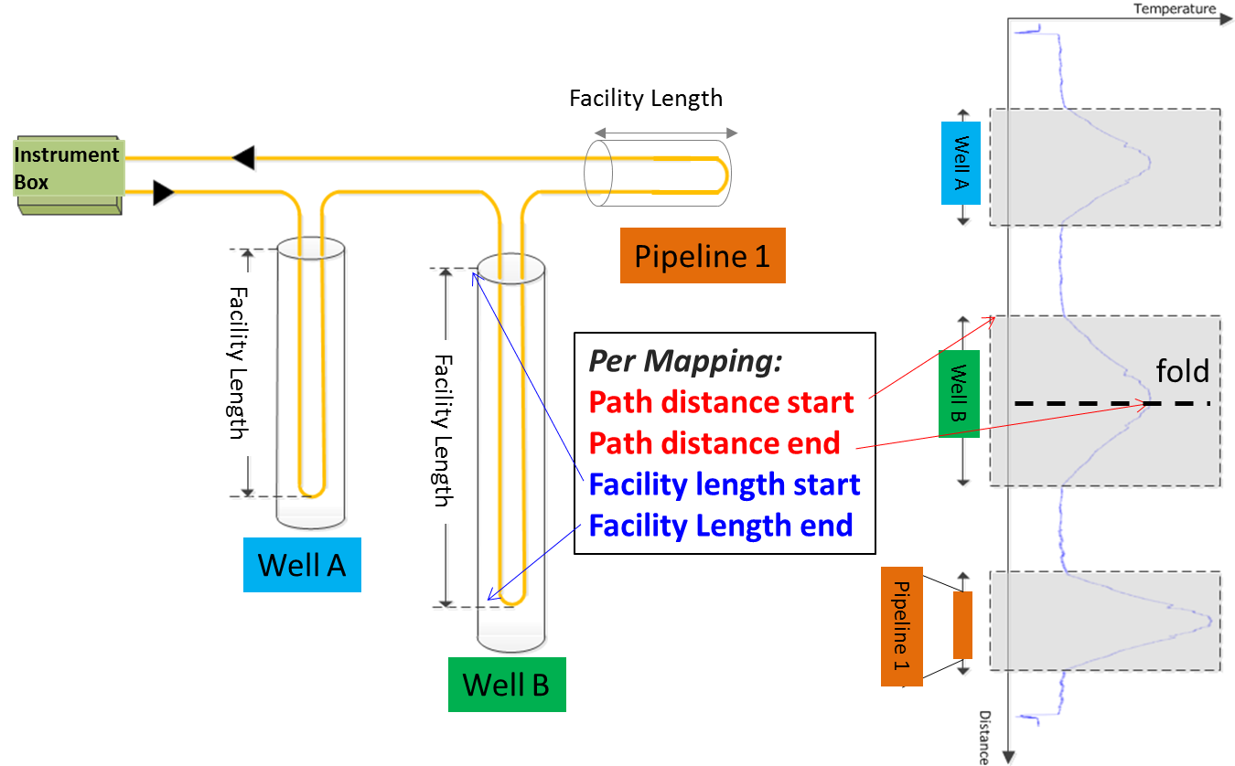
Fiber Facility Mapping links path distance to facility length, enabling facility “logs” to be made

Slide 18
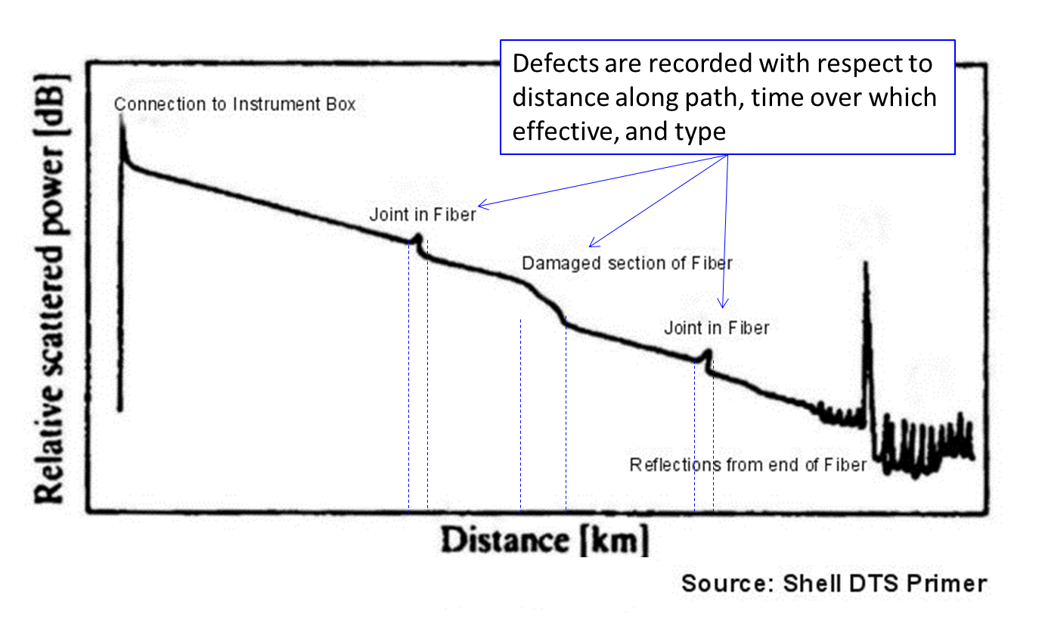
Fiber Defects recorded along Optical Path (Example data from OTDR test)

Slide 19
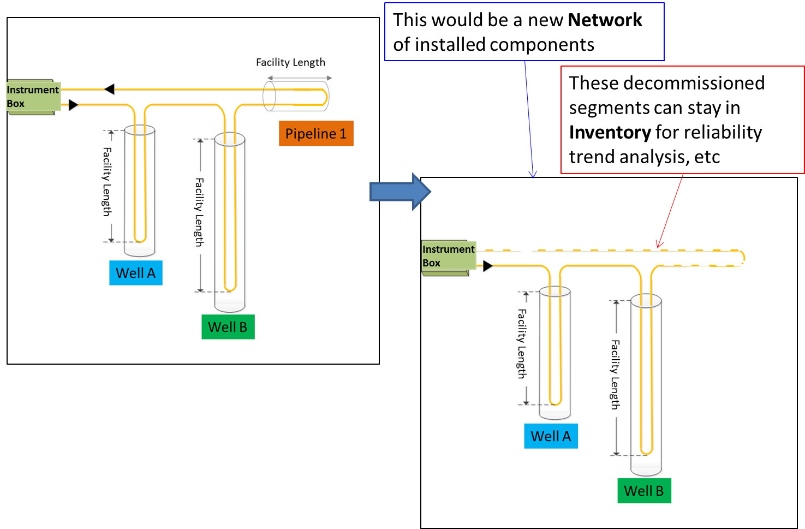
Optical Path may record changes over time: use of Inventory and Network allows for this

Slide 20
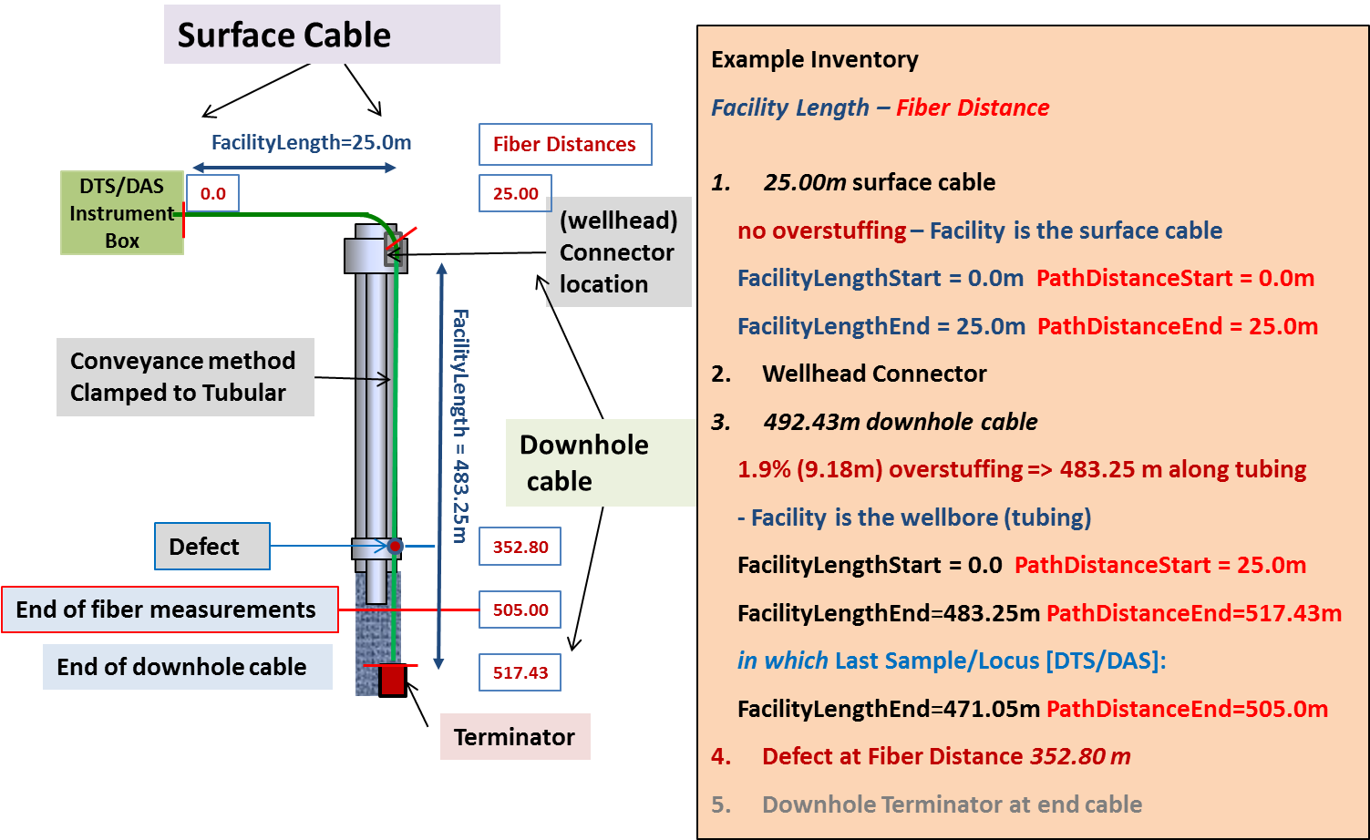
Simple Optical Path Example

Slide 21
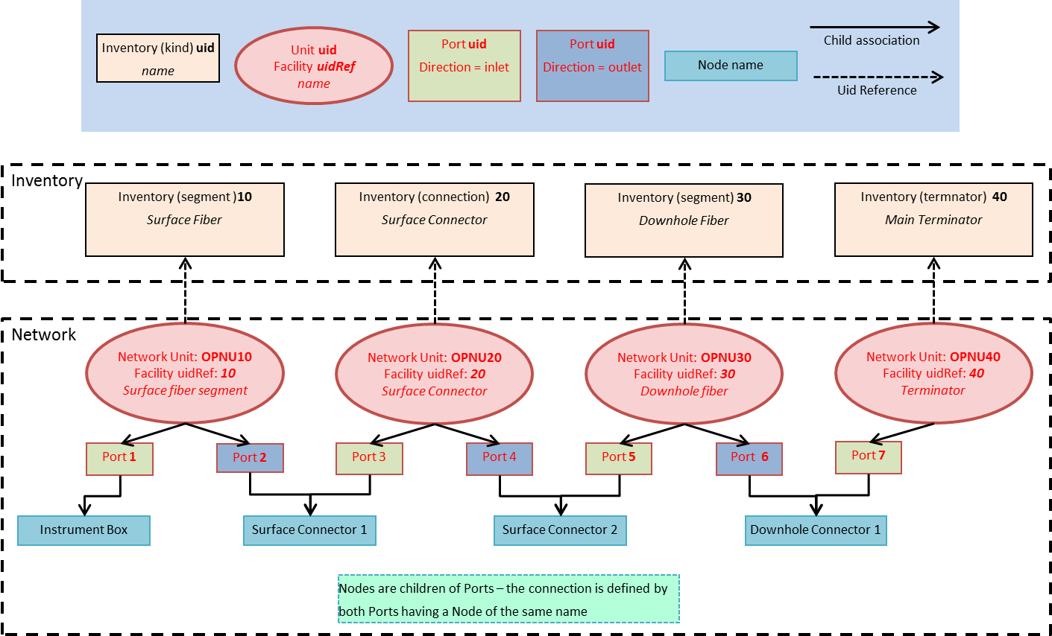
Optical Path example network showing connectivity

Slide 22
Instrument Box has properties and records calibration
Properties including reference temperatures, warm up time, etc.
Manufacturer details
Factory calibration details

Slide 23
Installed System is a combination of Instrument Box + Optical Path
Permanent Type
“Single Channel Instrument Box”
One fiber, one box, one facility
= 1 Installed System
“Multiplexed Instrument Box”
One box with multiplex, two facility, two fiber,
= 2 Installed System
Instrument
Box
Instrument
Box
Well A
Well B

Slide 24
Installed System (cont.)
Temporary Type
“Drive-by” DTS
One box taken to different facility/pre-installed fiber and hooked up for single survey
= 1 Installed System for each “drive-by hook up”
“Logging Operation”
One temporary fiber, one box, one facility
= 1 Installed System for each “logging operation”
Instrument
Box
Instrument
Box
Instrument
Box
Instrument
Box
Well A
Well B
Well C

Slide 25
DTS Measurement is the output from an operational DTS & is divided into two parts
The measured trace set which:
Is indexed against fiber distance
Can contain a controlled list of curves corresponding to “raw” data and temperature
The interpretation log set which:
Is indexed against facility length for a specific facility (e.g., like a well log)
Can contain only the processed temperature result

Slide 26
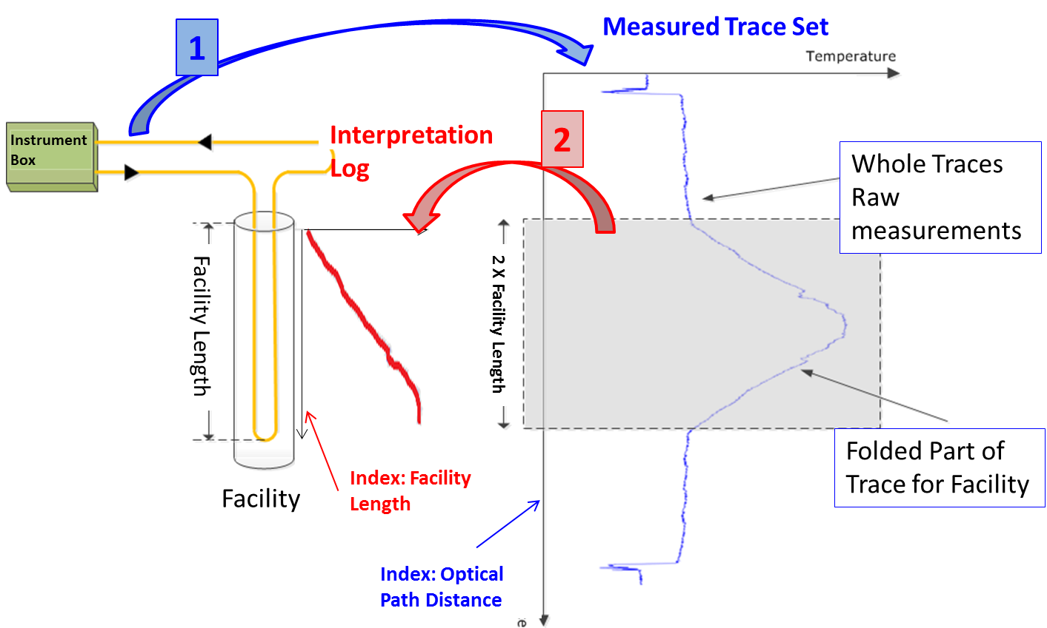
DTS Measurement Concept: 1 – record measured trace; 2 – record interpreted log

Slide 27
DTS Measurement – contains:
Only one set of traces/logs for a single DTS acquisition (over a time range)
Can contain “child” logs/traces which have been processed from parent logs, e.g. by averaging (parents may be in multiple other logs), recalibrated (from a parent), etc.
Measurement Tags to ID events, e.g. well start up; Diagnostic Parameters

Slide 28
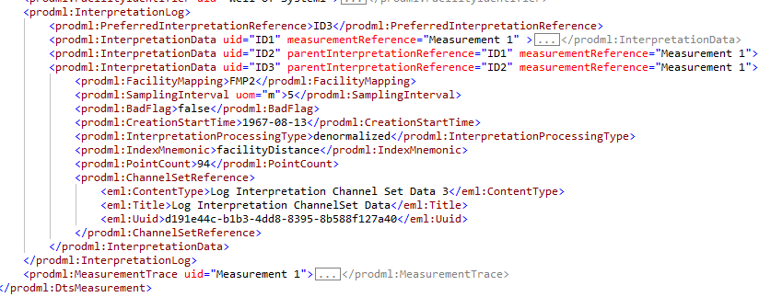
Multiple DTS interpretation logs in one transfer, showing preferred log, parentage, and processing type

Slide 29
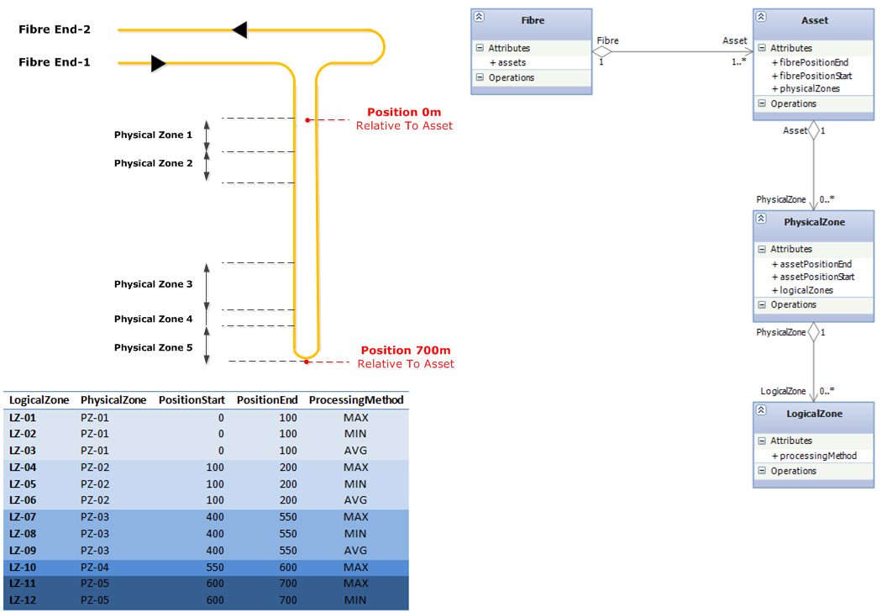
Facility Mapping could be used to define “zones”, e.g. contact intervals, to be reported using “mini-logs”

Slide 30
Summary
Major step in DTS reporting upgrades original standard for up to date practices
Multiple facilities on one path
Logging and other conveyance
Controlled lists of curves eliminates previous log curve ID ambiguity
Keeps measured and interpreted data together
Supports equipment tracking over time

Slide 31
Appendix - Technical

Slide 32
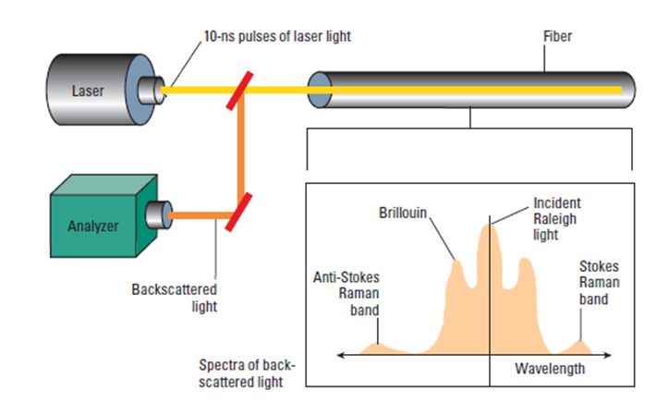
Principle of DTS: Laser light down optical fiber

Slide 33
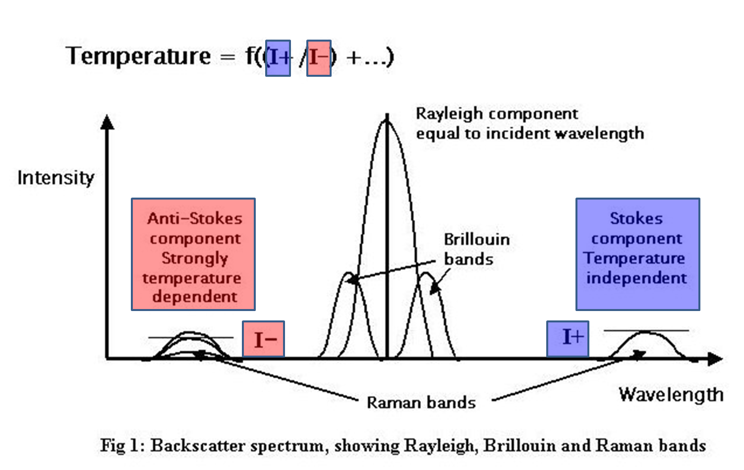
DTS uses back-scattered light to measure temperature all along the fiber

Slide 34
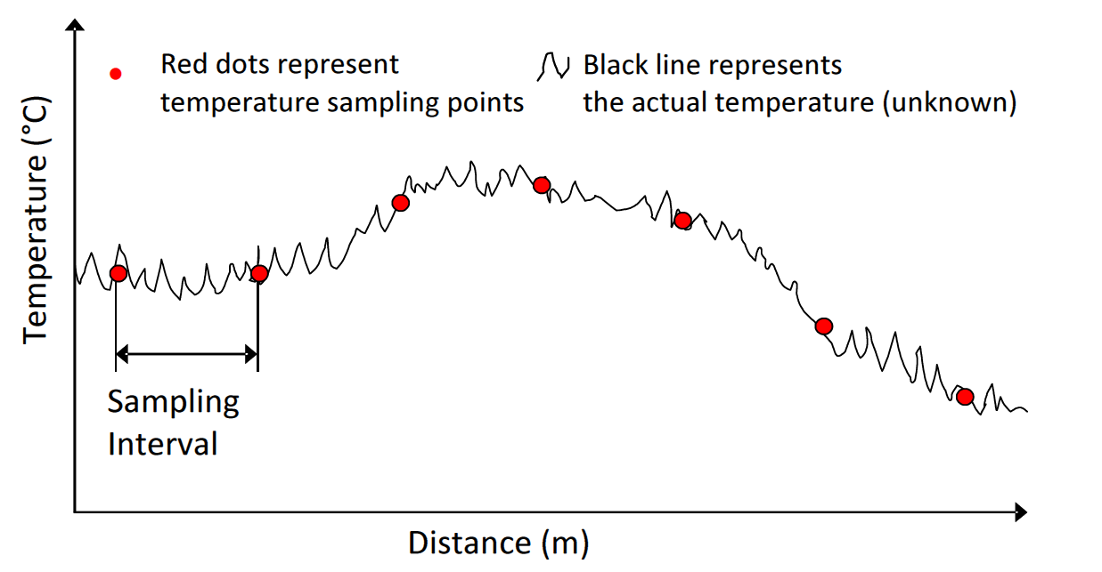
Temperature sampled at regular intervals creating a trace indexed along the fiber

